Slide 1
Wireworld in ClojureScript and PIXI.js

Slide 2
Wireworld
Empty → Empty
Electron head → Electron tail
Electron tail → Conductor
Conductor → Electron head if exactly one or two of the neighbouring cells are electron heads, or remains Conductor otherwise.

Slide 3
Wireworld
Empty → Empty
Electron head → Electron tail
Electron tail → Conductor
Conductor → Electron head if exactly one or two of the neighbouring cells are electron heads, or remains Conductor otherwise.

Slide 4
Wireworld
Empty → Empty
Electron head → Electron tail
Electron tail → Conductor
Conductor → Electron head if exactly one or two of the neighbouring cells are electron heads, or remains Conductor otherwise.

Slide 5
Wireworld
Empty → Empty
Electron head → Electron tail
Electron tail → Conductor
Conductor → Electron head if exactly one or two of the neighbouring cells are electron heads, or remains Conductor otherwise.

Slide 6
Wireworld
Empty → Empty
Electron head → Electron tail
Electron tail → Conductor
Conductor → Electron head if exactly one or two of the neighbouring cells are electron heads, or remains Conductor otherwise.

Slide 7
Wireworld
Empty → Empty
Electron head → Electron tail
Electron tail → Conductor
Conductor → Electron head if exactly one or two of the neighbouring cells are electron heads, or remains Conductor otherwise.

Slide 8
Wireworld
Empty → Empty
Electron head → Electron tail
Electron tail → Conductor
Conductor → Electron head if exactly one or two of the neighbouring cells are electron heads, or remains Conductor otherwise.

Slide 9
Wireworld
Empty → Empty
Electron head → Electron tail
Electron tail → Conductor
Conductor → Electron head if exactly one or two of the neighbouring cells are electron heads, or remains Conductor otherwise.

Slide 10
Wireworld
Empty → Empty
Electron head → Electron tail
Electron tail → Conductor
Conductor → Electron head if exactly one or two of the neighbouring cells are electron heads, or remains Conductor otherwise.

Slide 11
Wireworld
Empty → Empty
Electron head → Electron tail
Electron tail → Conductor
Conductor → Electron head if exactly one or two of the neighbouring cells are electron heads, or remains Conductor otherwise.

Slide 12
Wireworld
Empty → Empty
Electron head → Electron tail
Electron tail → Conductor
Conductor → Electron head if exactly one or two of the neighbouring cells are electron heads, or remains Conductor otherwise.

Slide 13
Wireworld
Empty → Empty
Electron head → Electron tail
Electron tail → Conductor
Conductor → Electron head if exactly one or two of the neighbouring cells are electron heads, or remains Conductor otherwise.

Slide 14
Wireworld
Empty → Empty
Electron head → Electron tail
Electron tail → Conductor
Conductor → Electron head if exactly one or two of the neighbouring cells are electron heads, or remains Conductor otherwise.

Slide 15
PIXI.js
http://www.pixijs.com/
HTML 5 Canvas/WebGL 2D rendering engine
Animated sprites, shapes, filters, custom shaders…

Slide 16
PIXI.js
//Create the renderer
var renderer = PIXI.autoDetectRenderer(256, 256);
//Add the canvas to the HTML document
document.body.appendChild(renderer.view);
//Create a container object called the `stage`
var stage = new PIXI.Container();
//Tell the `renderer` to `render` the `stage`
renderer.render(stage);

Slide 17
PIXI.js
//Create the renderer
(def renderer (.autoDetectRenderer js/PIXI 256 256)
//Add the canvas to the HTML document
(.appendChild js/document.body (.-view renderer))
//Create a container object called the `stage`
(def stage (new js/PIXI.Container)
//Tell the `renderer` to `render` the `stage`
(.render renderer stage)

Slide 18
PIXI.js

Slide 19
PIXI.js
(def texture (.fromImage js/PIXI.Texture "assets/cat.png")))
(def sprite (new js/PIXI.Sprite texture))
(.addChild stage sprite)
(.render renderer stage)

Slide 20
PIXI.js

Slide 21
PIXI.js
(set! (.-x sprite) 96)
(set! (.-y sprite) 96)
(.render renderer stage)

Slide 22
PIXI.js

Slide 23
PIXI.js
(set! (.-x sprite) 96)
(set! (.-y sprite) 96)
(set! (.-width sprite) 80)
(set! (.-height sprite) 120)
(.render renderer stage)

Slide 24
PIXI.js

Slide 25
PIXI.js
(set! (.-texture sprite) new-texture)

Slide 26
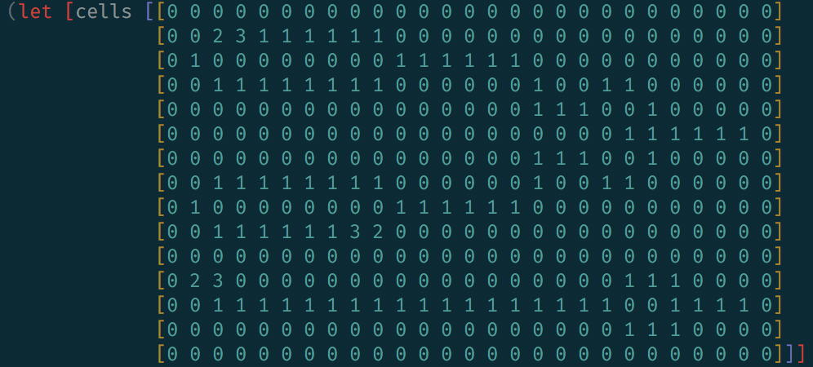
Wireworld in PIXI.js
 | Copper, represented as 1
 | Electron head, represented as 3
 | Electron tail, represented as 2
 | Blank, represented as 0

Slide 27
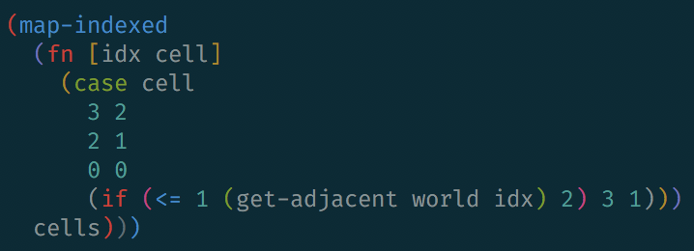
Transition from one generation to the next
0 -> 0
3 -> 2
2 -> 1
1 -> 3 if exactly one or two neighbours are “3” otherwise 1

Slide 28
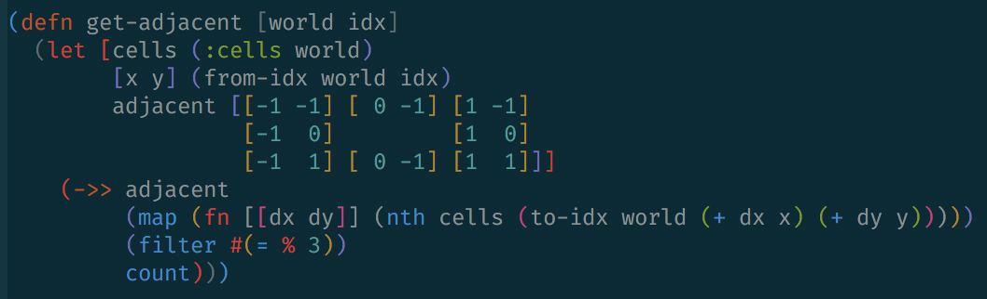
Count neighbouring electron heads
 | 2

Slide 29
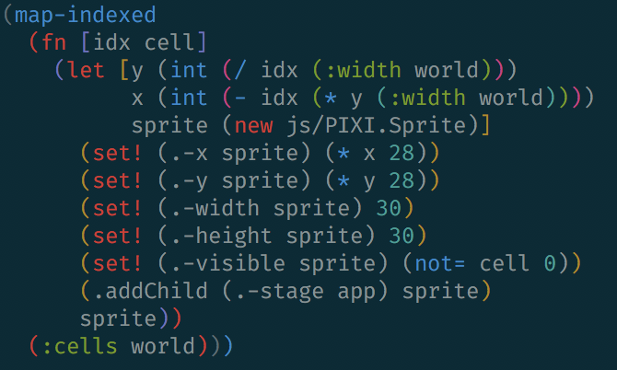
Initialise Sprites

Slide 30
Initialise Textures

Slide 31
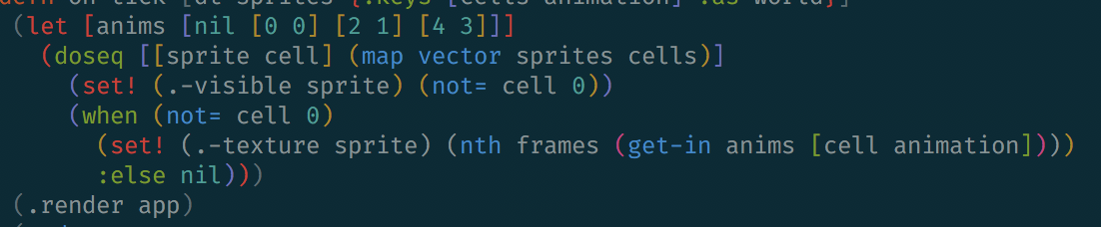
Draw Sprites

Slide 32
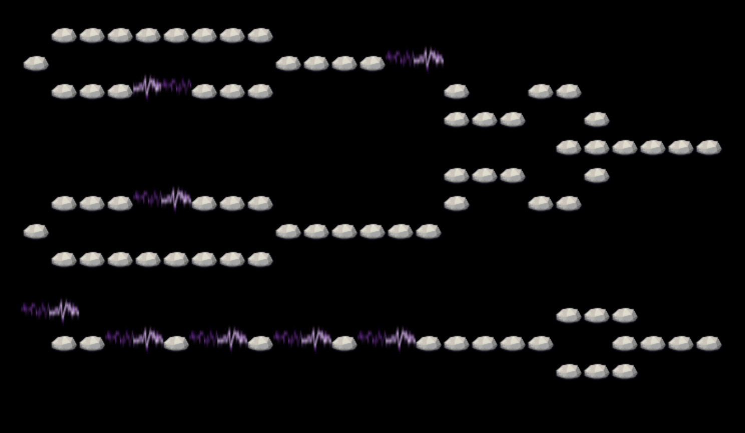
Putting it all together…

Slide 33
Demo

Slide 34
Questions?

